Slide 1


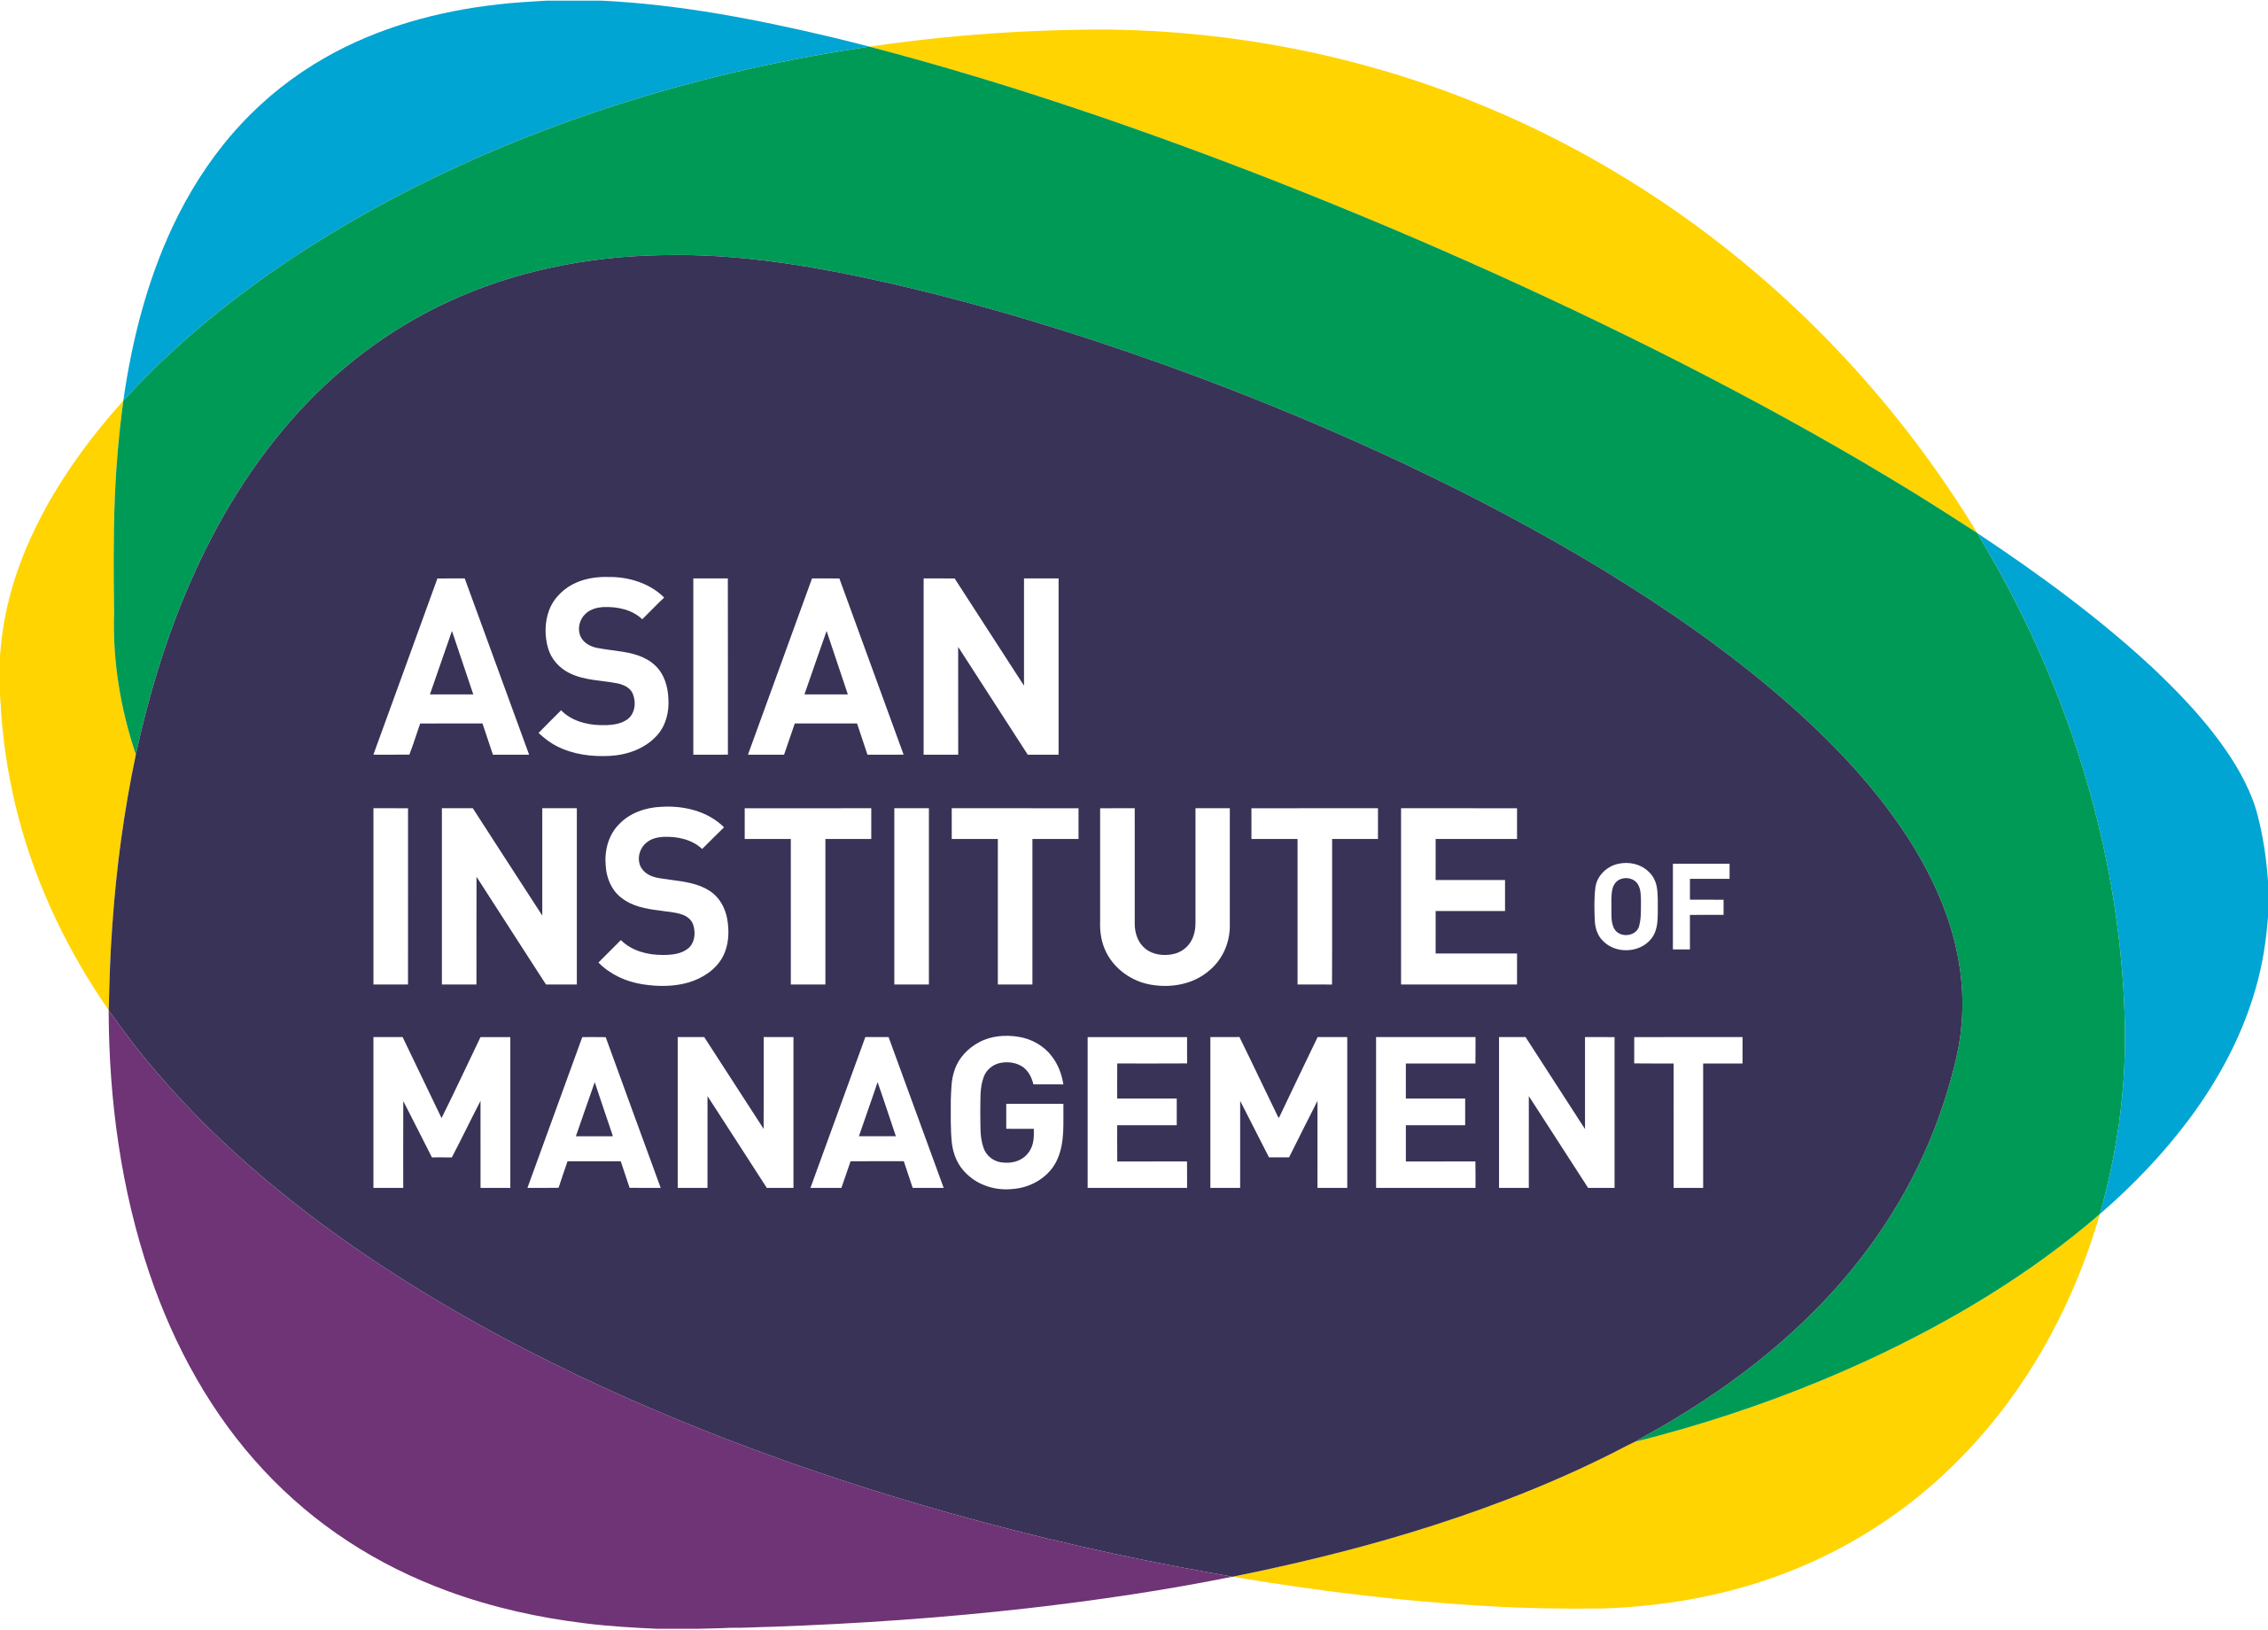


School of Executive Education and Lifelong Learning
Predicting Student Dropout Risk:
A Data-Driven Strategic Initiative
AI and ML Capstone Project – Education Domain
By: Conrado Banjo B Mamaradlo, Jr.
Postgraduate Diploma in AI and ML
January 2026
Notes:
Good morning. I am here to present a strategic initiative that transforms how we approach student success. In higher education, student dropout is rarely a sudden event; it is a process that leaves digital breadcrumbs long before a student actually leaves.
In this presentation, I will demonstrate how we have harnessed supervised machine learning to identify these early signals. Our goal is to shift from reactive management to proactive intervention, ensuring every student has the support they need to succeed while optimizing our institutional resources.
We will focus on the Return on Investment (ROI) of this technology, the ethical safeguards we have built-in, and the strategic roadmap for integrating this into our daily operations.

Slide 2

The Business Imperative: Why We Must Act
The Problem: Traditional ”early warnings” often arrive too late, after academic decline is irreversible.
Institutional Impact: High dropout rates lead to lost tuition revenue, diminished reputational standing, and inefficient support delivery.
The Opportunity: Leveraging historical data to predict future risk allows for targeted, high-impact interventions
Notes:
Currently, our advisors are often alerted to a student's struggle only after a failing grade is posted or a semester is missed. By then, the cost of recovery—both for the student and the institution—is at its highest. This project treats dropout as a solvable data problem.
From a business perspective, every student we retain represents preserved revenue and a successful fulfillment of our educational mission. Furthermore, a high completion rate is a key metric for institutional ranking and public trust.
Our model provides the decision support needed to prioritize our limited human resources—our advisors and tutors—where they are needed most, ensuring that no at-risk student falls through the cracks due to lack of visibility.

Slide 3

ROI Strategy: From Probabilities to Savings
Efficiency
Resource
Optimization
Revenue
Preservation
Automated screening of thousands of records to identify the top 10% highest-risk individuals.
Directing tutoring and counseling services to those with the highest "Risk Scores".
Lowering attrition directly correlates with stabilized tuition cycles and long-term alumni value.
4,424
Raw Records
Top 1o%
Intervention
List
AI Filtering
Notes:
The ROI of this project is rooted in efficiency and precision. We analyzed 4,424 student records across 37 different variables. Manually auditing this volume of data to find at-risk students is impossible for a human team to do consistently.
By implementing a "Top 10% Intervention Policy," we focus our intensive support resources on the students most likely to benefit. This isn't just about saving students; it's about saving time for our staff so they can focus on high-value interactions.
In the private sector, this is akin to reducing customer churn. In education, it's about maximizing the "Life Time Value" of a student’s journey from enrollment to graduation.

Slide 4
Technical Foundation: Simplified
Dataset: 4,424 records with 37 variables (academic, socioeconomic, and demographic)
Algorithm: Supervised classification using historical “Dropout vs. Graduate” labels.
Performance: Evaluated via ROC – AUC to ensure the model ranks risk accurately across imbalanced populations
Notes:
I want to assure you that this is not a "black box." We used a robust, peer-reviewed dataset to train and validate our approach. The model looks at everything from admission grades to mid-semester curricular unit performance.
Technically, we treat this as a supervised classification task. We taught the computer what a "dropout" profile looks like based on thousands of past examples. It then applies those patterns to current students to give them a risk score.
We prioritized the "ROC-AUC" metric because it is the gold standard for imbalanced data—ensuring that the model is just as good at finding the minority of dropouts as it is at identifying the majority of graduates.

Slide 5
Understanding the “Risk Score”
Actionable Intelligence
Prioritization
Non-Deterministic
Each student receives a probability score (0% to 100%).
High scrores trigger immediate human review
The model suggest risk; it does not dictate a student’s identity
"AI provides the 'Who,' our experts provide the 'How.'"
Notes:
It is vital to understand that the model's output is a "Risk Score," not a final judgment. We are using these scores as a "Decision Support" tool. A high risk score is a signal for an advisor to pick up the phone or schedule a meeting.
We recognize that data doesn't tell the whole story. A student might have a high risk score due to temporary personal circumstances that the model can't see. That is why human-in-the-loop is a core part of our strategy.
This score allows us to be surgical. Instead of "mass emails" to all students, which often get ignored, we can provide personalized outreach that acknowledges the specific challenges a student might be facing.

Slide 6

Strategy: Integrating AI into Advising
High Risk
One-on-one counseling.
Moderate Risk
Peer tutoring and automated check-ins.
Low Risk
Standard academic tracking.
Notes:
Our implementation strategy is built on a tiered support model. Not every student needs the same level of intervention. By using the model's risk tiers, we can distribute our support services more effectively.
The highest-risk 10% are flagged for our intensive "Success Coaching" program. This ensures our most expensive and time-consuming interventions are reserved for those who truly need them.
For the middle tier, we might use automated but personalized nudges—reminders about tutoring centers or study groups. This strategy allows us to scale our impact without exponentially increasing our headcount.

Slide 7



Ethical AI & Risk Management
Bias Auditing
Mitigation
Transparency
We conducted a fairness audit specially looking at Gender
Strategies like “Reweighting” were tested to ensure fair access to support
Every prediction is auditable and documented for institutional review
Notes:
In the educational sector, fairness is not optional—it is a requirement. We took proactive steps to ensure our model does not unintentionally penalize students based on sensitive attributes like gender.
We performed what is called a "Fairness Audit." We checked metrics like the "Disparate Impact Ratio" to ensure that being flagged for support was based on academic risk, not demographic profile.
If we found a gap, we applied mitigation strategies during the training process to level the playing field. We want to ensure that "AI-driven" does not mean "AI-biased."

Slide 8



Key Drivers of Dropout (What the AI Sees)
Academic
Momentum
Socioeconomic
Stability
Background
Success in 1st and 2nd-semester curricular units is the strongest predictor.
Tuition fee status and scholarship status are secondary but critical flags.
Age at enrollment and admission grades provide the baseline context.
Notes:
When we ask what the system is actually paying attention to, the most important signal is what I call academic momentum. Simply put, students who successfully complete more units in their first year are far more likely to persist. This confirms what educators already know intuitively, but now we can see it consistently across the entire student population.
The second driver relates to socioeconomic stability. Students who struggle with tuition payments or who do not have scholarship support tend to face higher levels of pressure outside the classroom. What this allows us to do strategically is involve the right support units earlier, such as financial aid offices, instead of waiting until academic performance declines.
The third driver, background, is often misunderstood, so I want to be very clear about how it is used. Factors like age at enrollment and admission grades do not define a student’s potential, and they are not treated as reasons for intervention on their own. Instead, they provide baseline context that helps us interpret other signals correctly. For example, a mature student or someone entering through a non-traditional pathway may face different structural challenges. Understanding this context helps leaders design fairer, more appropriate support strategies rather than one-size-fits-all policies.

Slide 9


Operational Safeguards
Model Drift
Monitoring
Human
Oversight
Data
Privacy
Regular retraining to account for changing student demographics.
Final intervention decisions remain with academic leadership.
Strict adherence to student data protection protocols.
Notes:
We have built "Risk Controls" into the deployment of this model. We know that the student population of 2026 might be different from the population of 2024. Therefore, the model will be recalibrated annually to avoid "Model Drift".
Data privacy is our top priority. The model uses structured records for training, but once in production, it operates within our secure, permission-based environment.
Most importantly, the model has no power to "dismiss" a student. It is strictly a "Recommendation Engine" for support. The human advisor is the final authority.

Slide 10
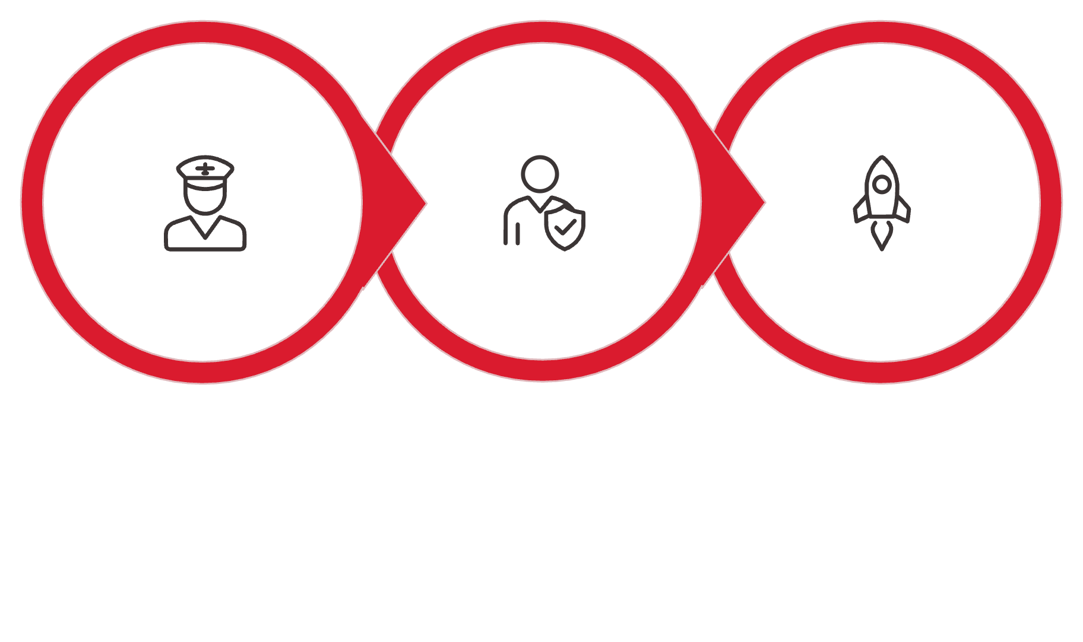



Implementation Roadmap (Next 12 Months)
Pilot 1-3
Integrate 4-8
Rollout 9-12
Notes:
We aren't suggesting a "big bang" rollout. We propose a phased approach starting with a pilot program. This allows us to verify that our intervention strategies (the "How") are actually working before we scale the AI (the "Who") to the entire institution.
During Phase 2, we will integrate the risk scores directly into the dashboards our advisors already use. We want this to be a seamless part of their workflow, not another tool they have to login to separately.
By the end of the year, we will have our first "Full Loop" of data—allowing us to measure exactly how many "at-risk" students we successfully moved to the "graduate" category.

Slide 11

THANK YOU
The future lies in collaboration between people and intelligent systems.
Notes:
As I conclude, I want to emphasize that this project is not about technology for its own sake. It is about using evidence responsibly to support better institutional decisions. Throughout this presentation, I have shown how early, data-informed prioritization can improve retention outcomes, protect institutional resources, and strengthen student success—without removing human judgment or ethical oversight.
From a return-on-investment perspective, even small improvements in retention among high-risk students can translate into meaningful financial and operational benefits. From a risk perspective, this approach is deliberately conservative: it is transparent, auditable, and governed by human decision-makers. And from a strategic perspective, the phased roadmap allows institutions to start small, learn safely, and scale only when confidence is earned.
Ultimately, I see this initiative as a collaboration between people and intelligent systems. The system identifies where attention is most needed, but it is our educators, advisors, and leaders who determine how support is delivered. That balance—between evidence and experience—is what gives this project its strength and why I believe it has a high probability of success in real institutional settings.

